Slide 1
Eniac - Discount Strategy Impact Analysis A new discount strategy for the future
An Analysis by Yannick

Slide 2
My findings
Currently we do not see a clear & effective discount strategy.
Revenue is strongly affected by seasonality
Discounts do not align to seasonal events
This is potentially a lost opportunity for our goals of customer acquisition, satisfaction and retention

Slide 3
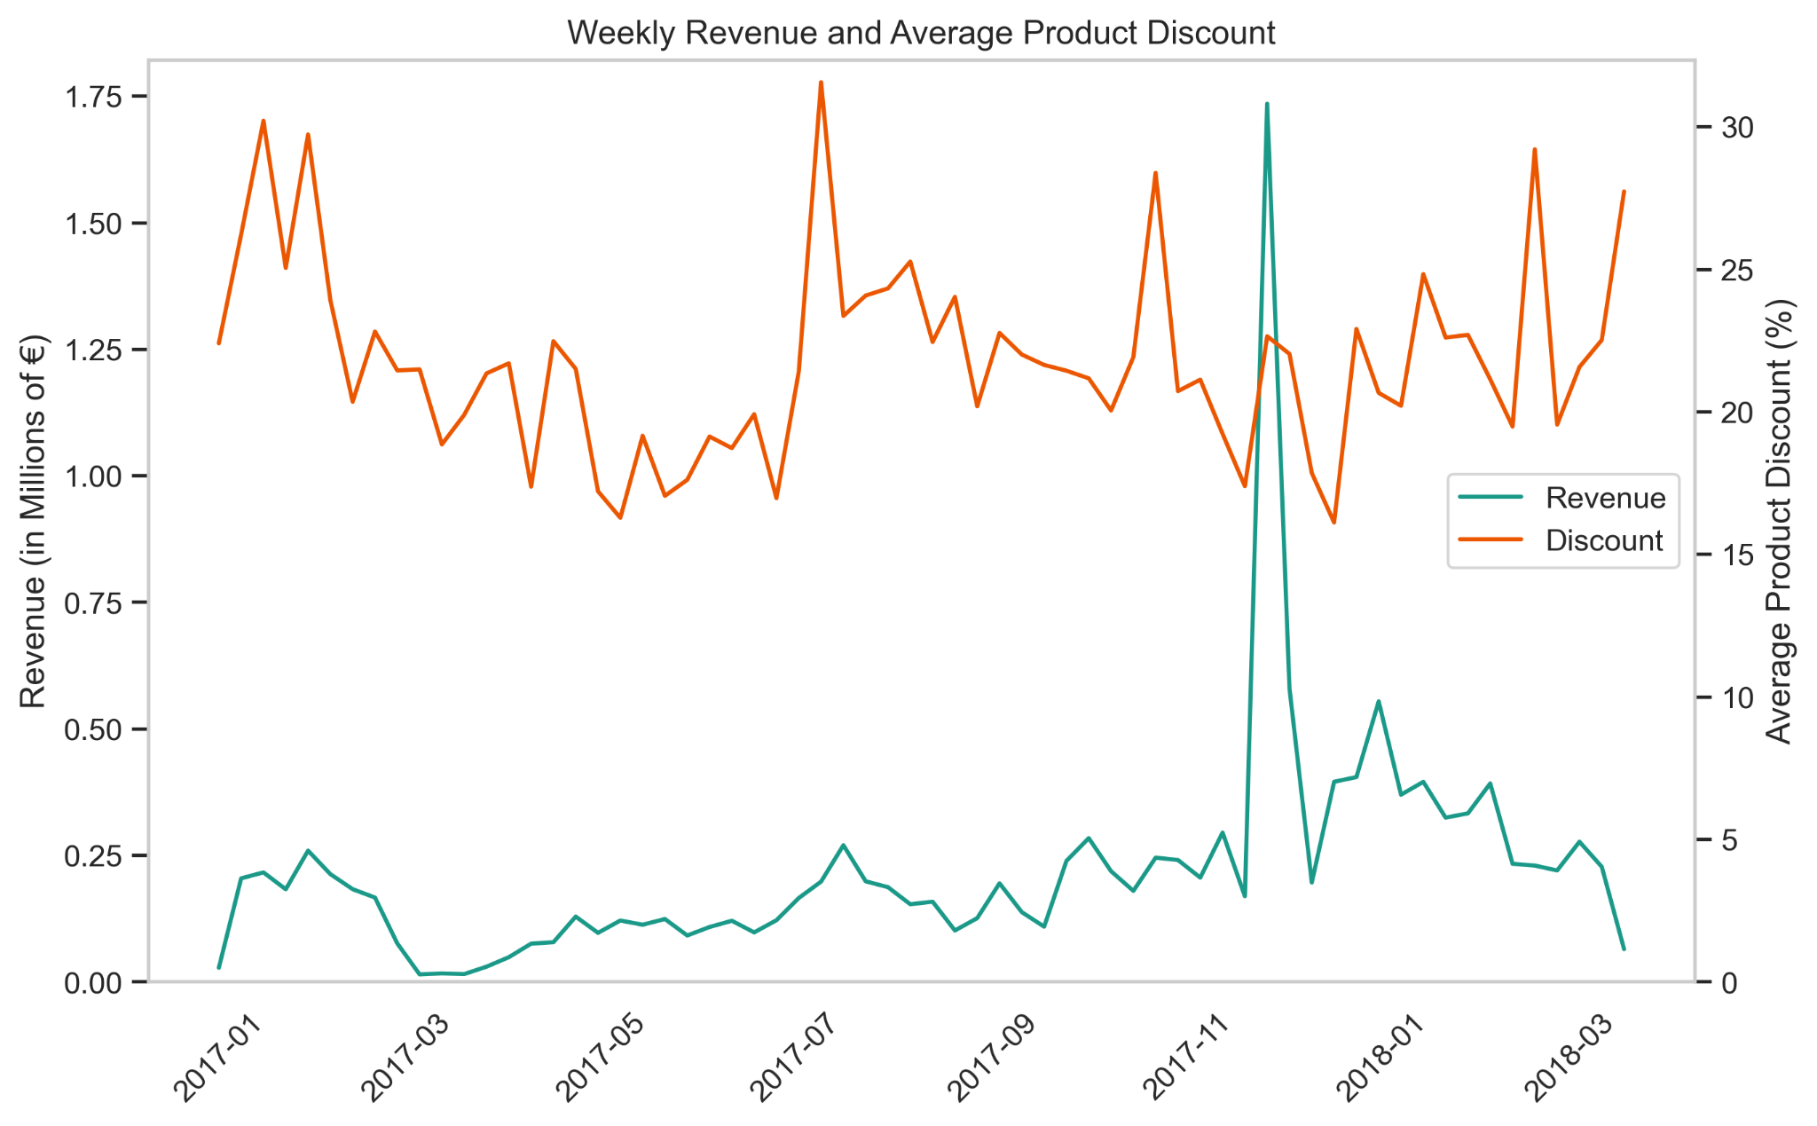
Current strategy shows no strong correlation between discounts and revenue

Slide 4
Seasonal Discounts have a huge potential for user growth
We do not use seasonal events to significantly increase discounts, but we still saw a huge increase in revenue around the time of Black Friday and Singles Day

Slide 5
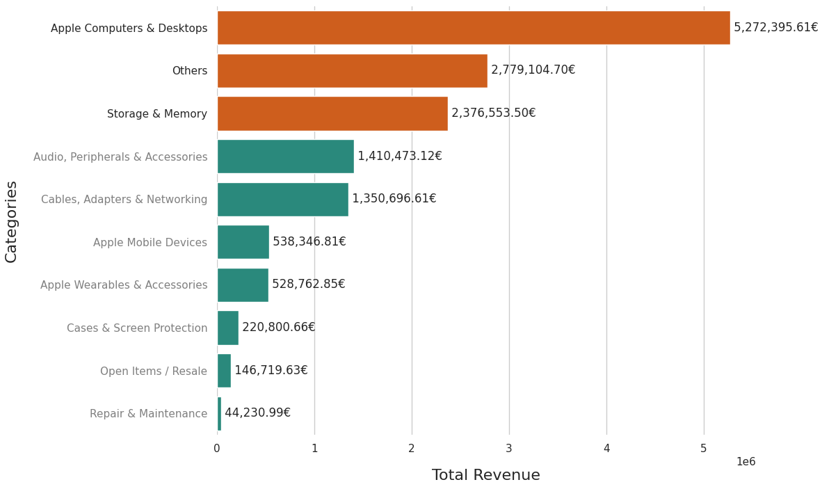

The main revenue driver is premium Apple products

Slide 6
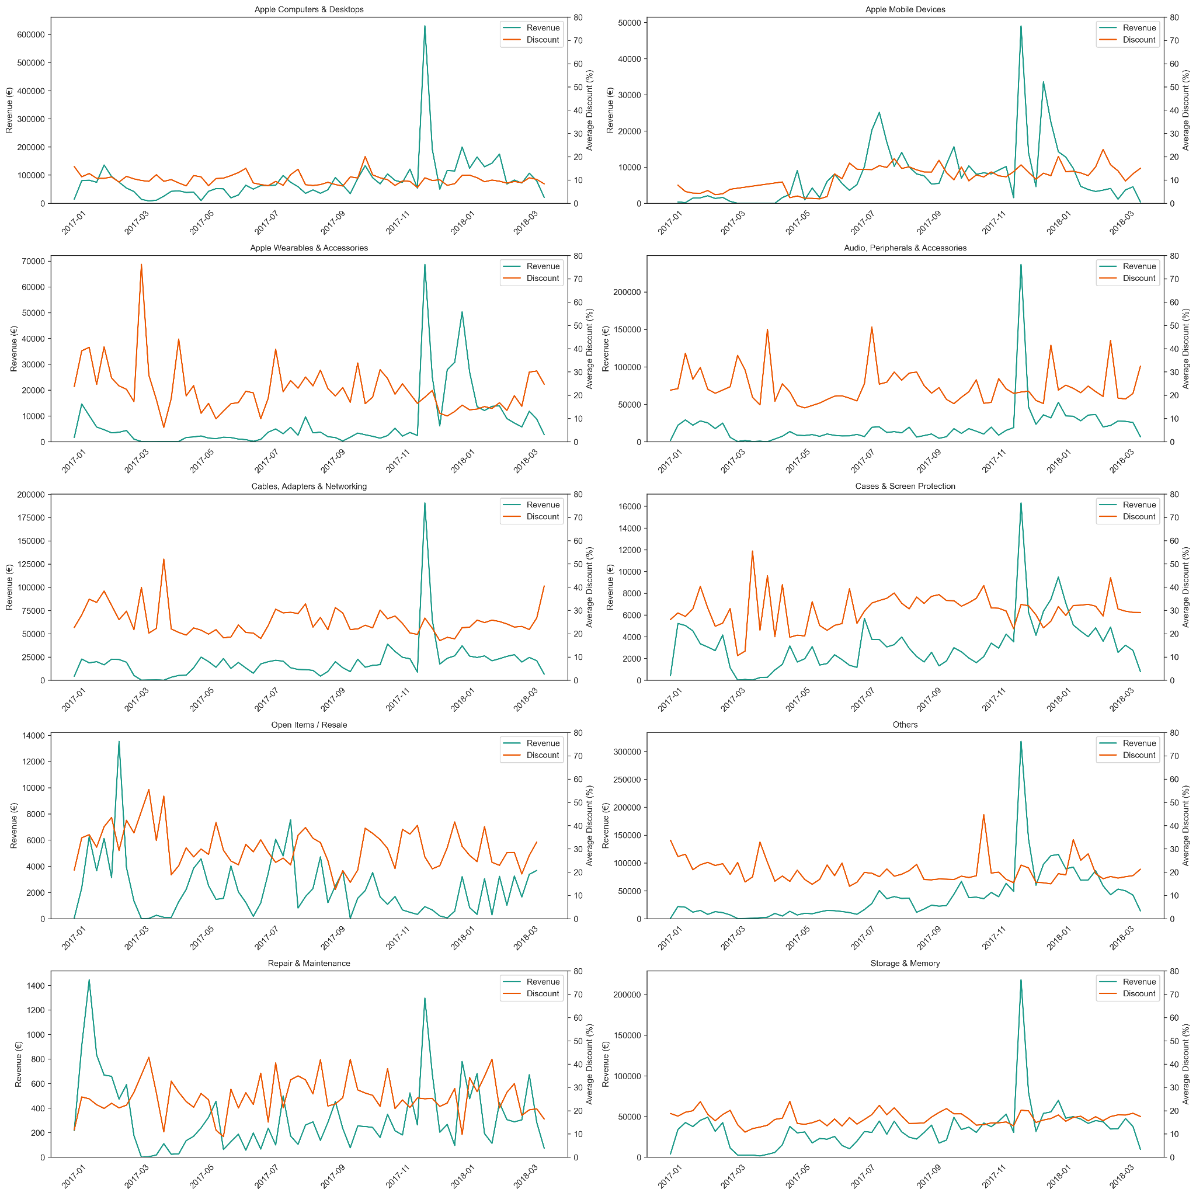
Premium products do not need high discounts

Slide 7
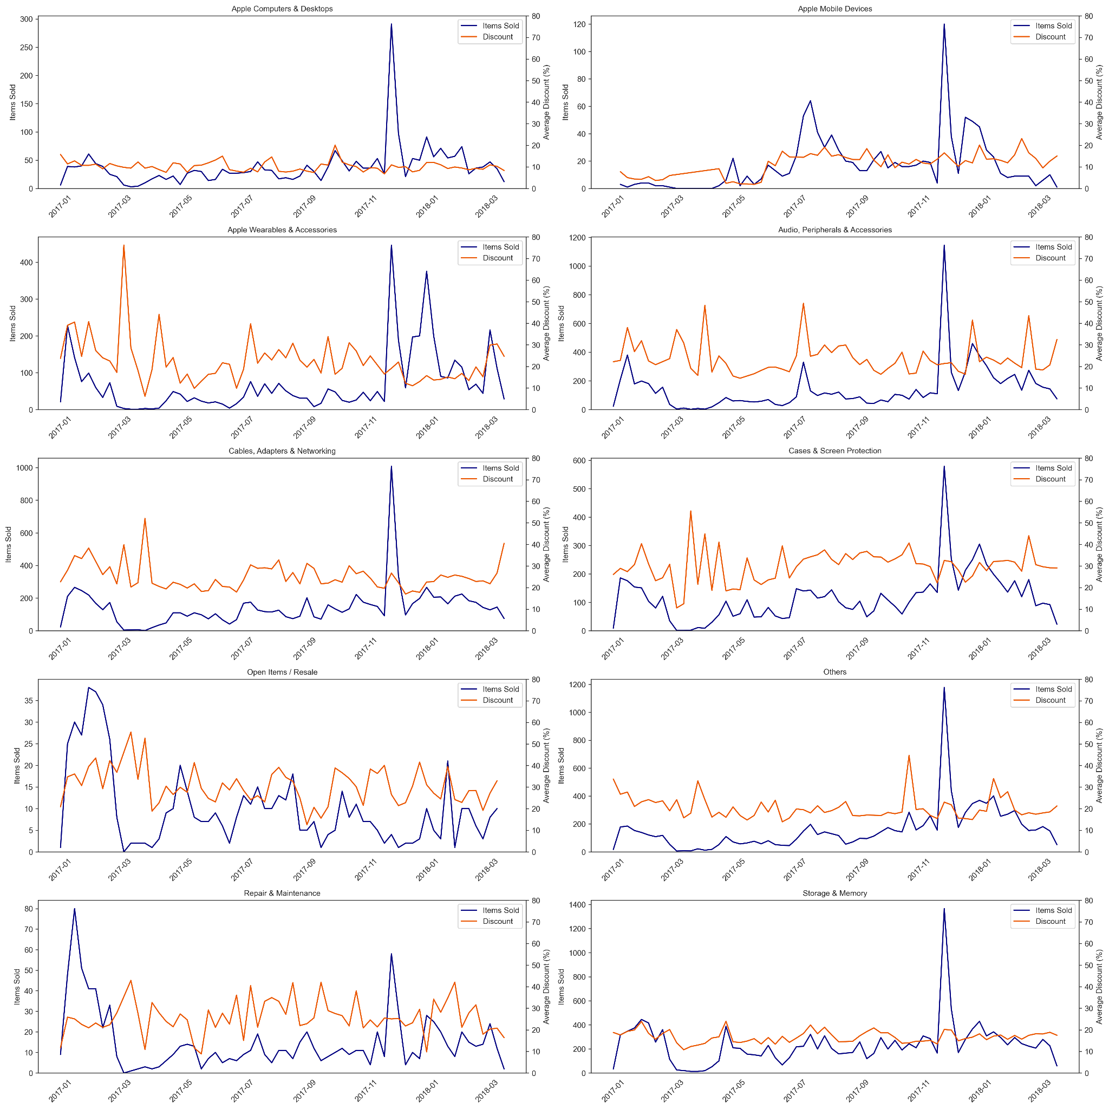
Lower price categories are ideal for discounts and sales

Slide 8
Suggesting a new discount strategy for ENIAC
Current strategy
92.3% of the sold items in our database were being discounted
We offer an average of 22.49% on products in our database
Spike in sales around Black Friday 2017
But NO sustainable growth of revenue after that
New Strategy
Strategic use of seasonal sales: Black Friday, Singles Day, Back-to-School
Use of Bundle Sales: Selling high value tech products along with accessories, we can bundle them together in sales
Achieve sustainable & consistent growth over time

Slide 9
How to improve data collection in the future
The data quality was compromised in several ways which affected every part of this analysis
BUT I was able to analyse 96% of the completed orders in the data
I currently have no data regarding the profitability of discounts since I do not know the purchase price of products Eniac sells
The prices and promo prices were heavily corrupted and a lot of data has been lost here
I could not use uncompleted orders, which were 80% of the entries in the database
I need more detailed user data in order to check for customer acquisition, retention and discount usage data. In order to analyze the success of future strategy changes, this has to be implemented immediately

Slide 10
Thank you for your attention.
An Analysis by Erick, Justice, Marco, Mariusz and Yannick

Slide 11
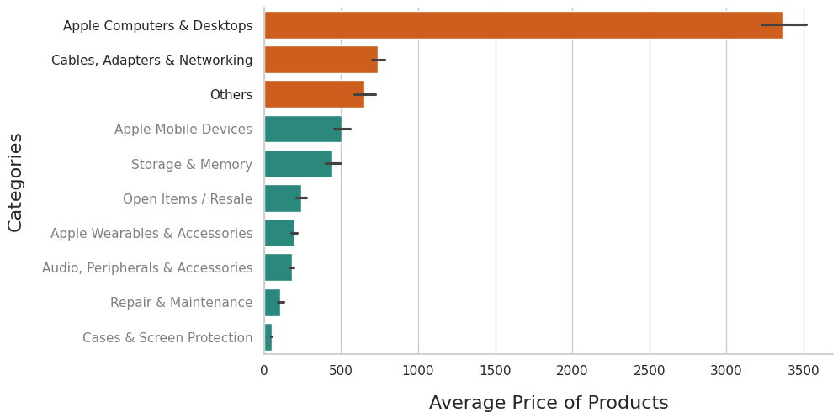
Accessories and smaller products fill out our range

Slide 12
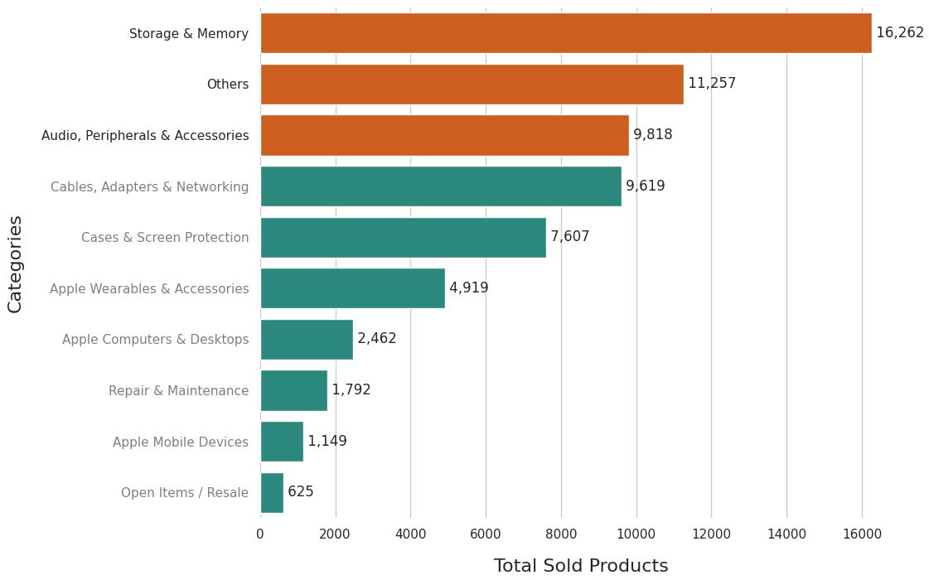
Top sellers

Slide 13
Lower price categories are ideal for discounts and sales

Slide 17
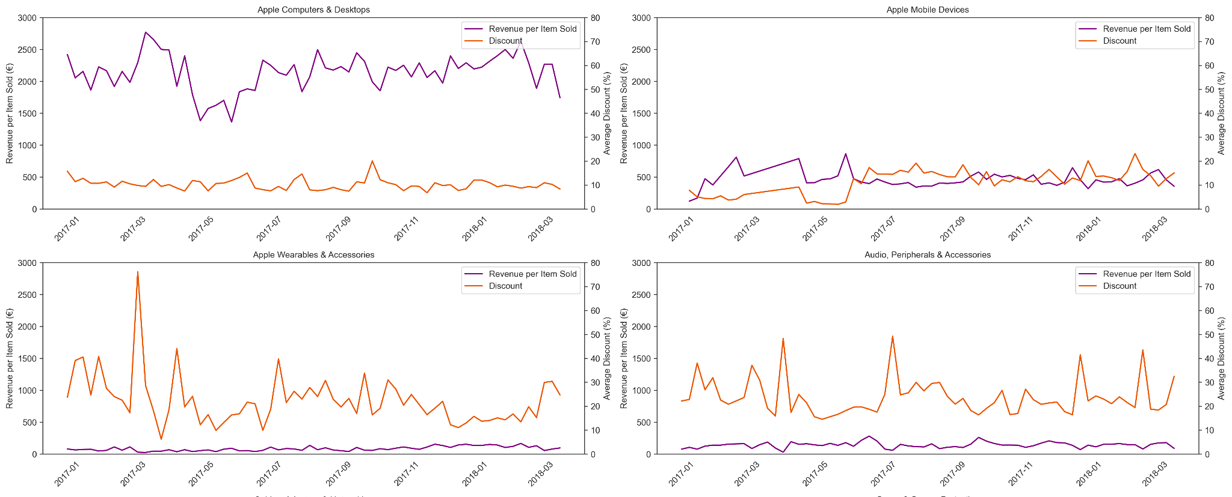

Slide 18
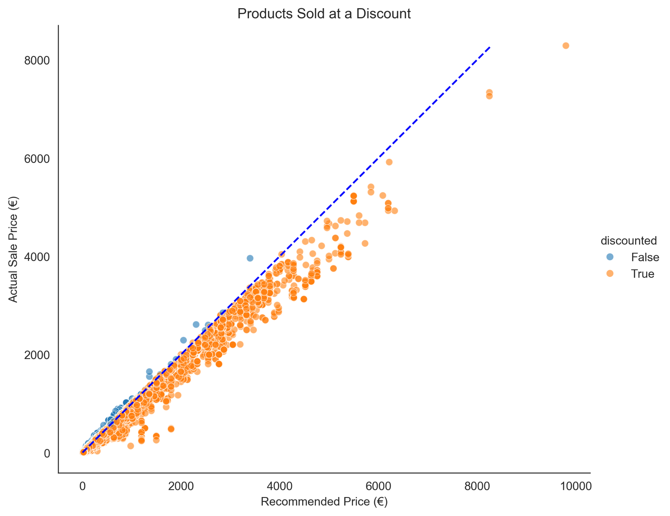

Slide 19
Product categorisation
Classification by type (current):
Top 9 types = 50% of products (50% would have to be considered as "Others')
Top 14 types = 60% of products (40% would have to be considered as "Others")
Top 21 types = 70% of products (30% would have to be considered as "Others")
Top 32 types = 80% of products (20% would have to be considered as "Others")
Top 52 types = 90% of products (10% would have to be considered as "Others")

